Slide 1
Thwarting Cache Side-Channel Attacks Through Dynamic Software Diversity
Presented by Xianchen Meng

Slide 2
Background Side-Channel Attacks
Definition:
In cryptography, a side-channel attack is any attack based on information gained from the physical implementation of a cryptosystem, rather than brute force or theoretical weaknesses in the algorithms (compare cryptanalysis).
Methods:
Timing attack
Power-monitoring attack
Electromagnetic attacks

Slide 3
Example
Different execution time

Slide 4
Background Cache structure

Slide 5
Background Example Attacks

Slide 6
Background Example Attacks

Slide 7
Motivation
Since code injection, code reuse, and reverse engineering attacks are all significantly harder against diversified software, the authors propose to extend software diversity to protect against side-channel attacks, in particular cache side channels.
artificial software diversity denies attackers precise knowledge of their target by randomizing implementation features of a program.

Slide 8
Current works & Limitations
Most existing diversification approaches randomize programs before execution.
e.g., during compilation, installation, or loading.
Ahead-of-time randomization is desirable
Some approaches interleave program randomization with a static method and program execution and the granularity of randomization in these approaches is quite coarse
Limitation: potentially allowing an attacker to observe the program uninterrupted for long enough to carry out a successful side-channel attack

Slide 9
Novelty control-flow randomization
Avoiding current problems by extending techniques used to prevent reverse engineering such as code replication and control-flow randomization
replicate code at a finer grained level
produce a nearly unlimited number of runtime paths by randomly switching between these replicas

Slide 10
Novelty Diversifying transformations
To vary the side-channel characteristics of replicas, authors employ diversifying transformations.
Diversification preserves the original program semantics while ensuring that each replica differs at the level of machine instructions.
Combine control-flow randomization with diversifying transformation to counter cache-based side-channel attacks
Called dynamic control-flow diversity

Slide 11
Dynamic control-flow diversity

Slide 12
Dynamic control-flow diversity
begin by choosing a set of program fragments (either functions or basic blocks) to transform
clone each chosen program fragment a configurable number of times and use different diversifying transformations for each clone
integrate these randomized replicas into a program that dynamically chooses control-flow paths at runtime

Slide 13
Dynamic control-flow diversity

Slide 14
Dynamic control-flow diversity

Slide 15
Cache Noise Transformation
The authors investigated one specific transformation, inserting cache noise, to disrupt cache side-channel observations.
This technique is only one example of possible side-channel disrupting transformations.
Inserting random memory loads
Static: addr = region_base + offset
Dynamic: addr = Memory[random_table[i]]

Slide 16
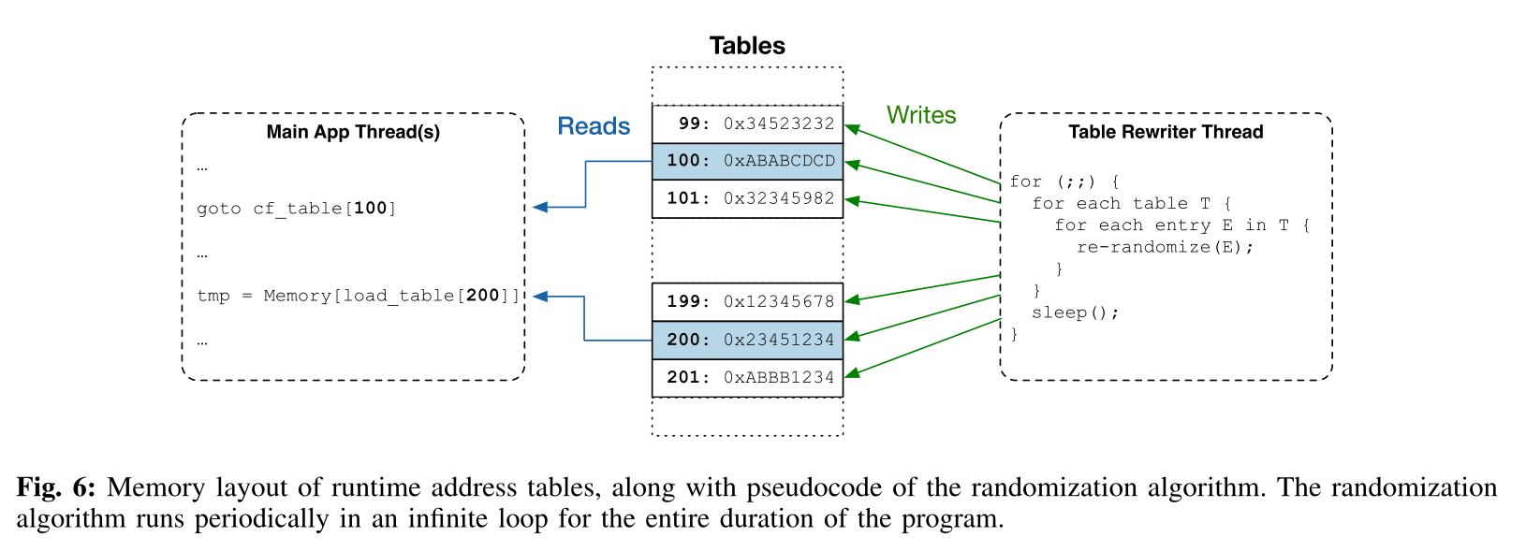
Table Randomization Optimization

Slide 17
Evaluation Security Evaluation

Slide 18
Evaluation Performance Evaluation

Slide 19
Evaluation Performance Evaluation

Slide 20
Evaluation Performance Evaluation
CPU intensive workloads

Slide 21
Quiz
1.what are the limitations of current works?
2. what does dynamic control-flow diversity consist of?
3.what is the principle method of authors’ work?

